Slide 1


Slide 2
WHAT TO EXPECT FROM THIS DAY
The aim of this day is to provide an overview of the mobility options available and help you understand in advance which opportunities are most relevant to you
The specific calls have not yet been published, so the information we will provide you today will be very general
Once you have decided where to start, we recommend that you read the calls from previous academic years and then come to us for further information.

Slide 3

🌍 Study abroad: complete part of your studies at a European university, and everything you do will be recognized by the University of Macerata as part of your study plan
💡 Discover new horizons: learn new ways of studying, meet other students from all over Europe with whom you can share a period of your life
🚀 Grow personally and socially: improve your language and intercultural skills and take advantage of the opportunity to meet many young people from all over Europe
📅 Next call: end of January 2026
✈️ Mobility period: August 2026 → July 2027
ERASMUS+ STUDY MOBILITY
Enriches your life, opens your mind

Slide 4
🎯 Financial support available: monthly grants and travel contributions for 2–12 months abroad
🌍 Open to all students: Bachelor’s, Master’s and one-cycle degrees (including first-year)
🧭 Host organizations: all European universities with which the University of Macerata has bilateral agreements
💬 Why join? To have the opportunity to study abroad, discover new ways of learning, and experience different cultures
🔎 Learn more and find the official call at:
iro.unimc.it → Studenti in partenza →Erasmus → Erasmus+ studio (https://iro.unimc.it/it/studenti/studenti-in-partenza/erasmus/erasmus.studio)
ERASMUS+ STUDY MOBILITY
Enriches your life, opens your mind

Slide 5

UNIADRION
Study or Train Across the Adriatic–Ionian Region
🌐 Where you can go: Albania, Bosnia & Herzegovina, Croatia, Greece, Slovenia, Serbia, Montenegro, North Macedonia
🚀 A regional Erasmus+ experience: strengthen skills, build connections, and discover the Adriatic–Ionian academic and cultural space
📝 How to apply: through the UniAdrion Italy calls at → https://www.uniadrionitaly.it/bandi-erasmus/
🤝 UNIMC support: students can get help preparing their Learning Agreement (Study or Traineeship) by contacting arint.umi@unimc.it
🎓 Who promotes it: UNIMC is part of UniAdrion Italy together with 10 Italian universities
🔎 Learn more and find the mobility opportunities for students and staff promoted by the Erasmus+ Consortium “Uniadrion Italy” at -> https://www.uniadrionitaly.it

Slide 6
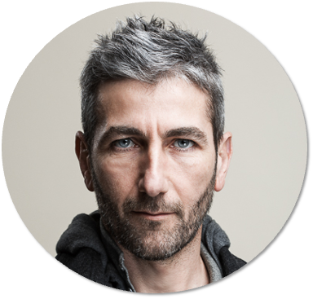
Administrative Contact person
International Mobility Off.
Enrico Ferretti enrico.ferretti@unimc.it

Slide 7

ERASMUS+ TRAINEESHIP MOBILITY
Experience the World of Work in Europe
🌍 Step into your first workplaces: choose your traineeship in museums, tour operators, hotels, schools, NGOs or public institutions in Germany, Spain, France and other EU countries
💼 Choose your dream job in your dream place in Europe: Erasmus makes your dream come true
🌐 Develop key skills: organisation, responsibility and languages
🚀 Prepare for your career: Erasmus + traineeship is the key to open your career after University
📅 Next call: end of February 2026
✈️ Mobility period: July 2026 → July 2027

Slide 8
ERASMUS+ TRAINEESHIP MOBILITY
Experience the World of Work in Europe
🎯 Financial support available: Erasmus Traineeship monthly grants and travel contributions
🌍 Mobilities before and after the graduation: Apply as a student and start the mobility before or after the graduation
🧭 How to find a company: our staff supports you with dedicated meetings
💬 Why join? Because your life changes after the Erasmus +Mobilities
🔎 Learn more and find the official call at:
iro.unimc.it → Studenti in partenza → Erasmus → Erasmus+ Traineeship (https://iro.unimc.it/it/studenti/studenti-in-partenza/erasmus/erasmus-tirocinio)

Slide 9

MAECI–CRUI
Internship Program — Italian Embassies Worldwide
🌍 What it is: a prestigious 2–3 month paid internship in Italian Embassies and Italian Cultural Institutes around the world.
🎓 Who can apply: only Italian Master’s Degree students.
📅 Next call: February 2026
✈️ Mobility period: May → July 2026
🏛️ How it works: choose the Embassy, apply online, and start an international traineeship in the heart of Italy’s diplomatic network.
🚀 Why join: real diplomatic experience, professional growth, and an inside look at Italy’s foreign affairs system.
🔎 Learn more:
https://www.unimc.it/it/didattica/stage-e-inserimento-lavorativo/stage-curriculari

Slide 10
Administrative Contact person
International Mobility Off.
Anna Bittarelli
anna.bittarelli@unimc.it

Slide 11

THE MAGELLANO PROGRAM
Your gateway to extra-European study opportunities
✈️ Study outside Europe in non-EU universities across multiple continents
🎓 Attend courses, take exams, and earn international academic credits (CFU)
🌐 Designed to promote global student mobility beyond Erasmus+ destinations
💰 Supported by UniMc scholarships for study periods abroad in non-EU institutions
📍 Destination countries include:
Argentina 🇦🇷 • Australia 🇦🇺 • Canada 🇨🇦 • Colombia 🇨🇴 • South Korea 🇰🇷 • Japan 🇯🇵 Indonesia 🇮🇩 • China 🇨🇳 • United States 🇺🇸 • Vietnam 🇻🇳

Slide 12
THE MAGELLANO PROGRAM
Your gateway to extra-European study opportunities
🗓️ Each Call for Applications is published according to the specific deadlines set by the partner universities
📢 Updates and new calls are also shared through official UniMc communication channels
💡 Tip: Check the website regularly to avoid missing important deadlines
🔎 Learn more and find the official call at
iro.unimc.it → Studenti in partenza (https://iro.unimc.it/it/studenti/studenti-in-partenza) → Programma Magellano

Slide 13
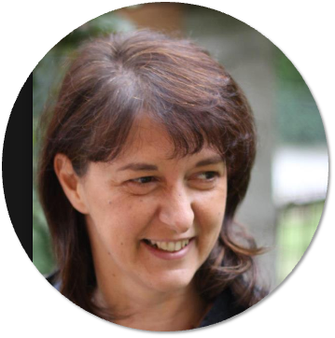
Administrative Contact person
International Mobility Off.
Paola Landi
paola.landi@unimc.it

Slide 14

RESEARCH ABROAD
Your Thesis, Your Passport to the World
🌍 Do research abroad: Carry out part of your thesis at a university, research center, or international institution worldwide
💡 Discover new perspectives: Access unique resources and new research methods beyond Italy
🤝 Connect globally: Collaborate with international mentors and enrich your academic network
🚀 Grow personally and professionally: Enhance your research, language, and intercultural skills — and shape your future
📅 Next call: October 2026
✈️ Mobility period: January 2026 → July 2027

Slide 15
RESEARCH ABROAD
Your Thesis, Your Passport to the World
🎯 Financial support: Financial contribution for 1–3 months abroad
🎓 Who can apply: Final-year students of Master’s and one-cycle degree courses
🌐 What you can do: Research for your final thesis, attend conferences, or collect materials abroad
💬 Why it matters: Turn your dissertation into a truly international story — your research without borders
🔎 Learn more and find the official call at
iro.unimc.it → Studenti in partenza (https://iro.unimc.it/it/studenti/studenti-in-partenza) → Ricerca tesi all’estero

Slide 16
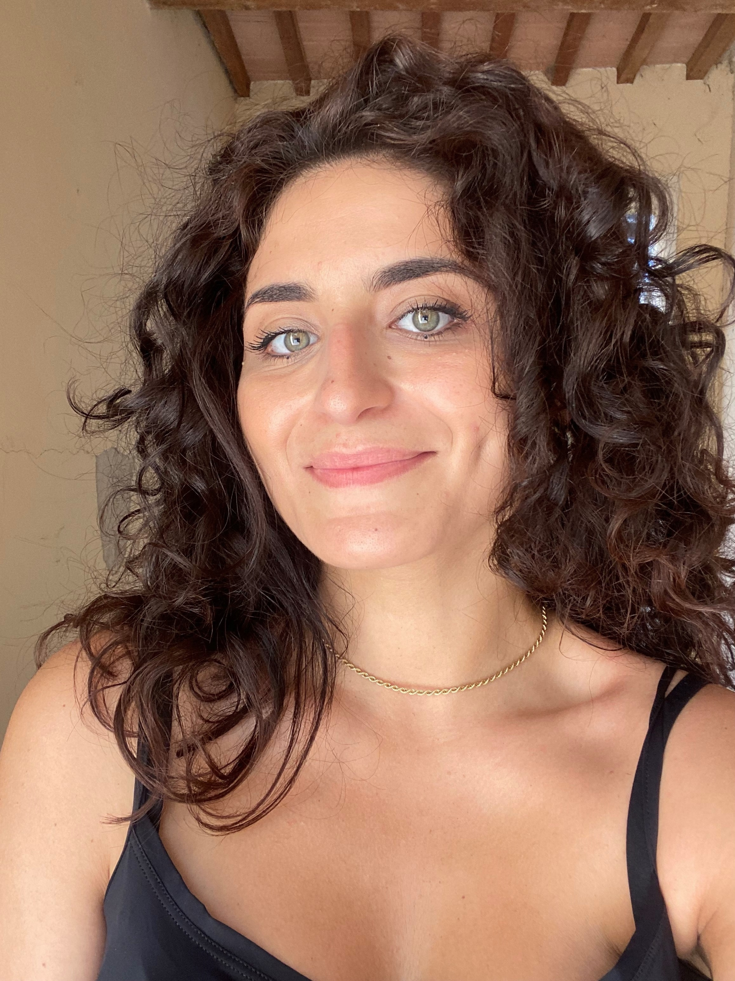
Administrative Contact person
International Mobility Off.
Anna de Santis
anna.desantis@unimc.it

Slide 17

INTERNSHIP PROGRAM IN NON-EU COUNTRIES
Experience the World of Work Beyond Europe
🌍 Step into global workplaces: train in companies, NGOs, universities, or public institutions in Asia, the Americas, Africa, Oceania, the UK, and Switzerland
💼 Learn by doing: apply your academic knowledge to real challenges
🌐 Develop key skills: creativity, adaptability, teamwork, and intercultural communication
🚀 Prepare for your career: an international internship today means opportunities tomorrow
📅 Next call: September 2026
✈️ Mobility period: January 2026 → July 2027

Slide 18
INTERNSHIP PROGRAM IN NON-EU COUNTRIES
Experience the World of Work Beyond Europe
🎯 Financial support available: monthly grants and travel contributions for 1–3 months abroad
🌍 Open to all students: Bachelor’s, Master’s and one-cycle degrees (including first-year)
🧭 Host organizations: companies, NGOs, research centers, schools, and diplomatic missions
💬 Why join? Because learning happens where cultures meet — make your skills truly international
🔎 Learn more and find the official call at
iro.unimc.it → Studenti in partenza (https://iro.unimc.it/it/studenti/studenti-in-partenza) → Tirocinio in Paesi extra-europei

Slide 19
Administrative Contact person
International Mobility Off.
Anna de Santis
anna.desantis@unimc.it

Slide 20

Download the Presentation
QR CODE

